Slide 1


Slide 2


Slide 3





Notes:
The presentation includes 4 chapters

Slide 5


Introduction
Notes:
In this chapter we will see timeline, and overview of the charging ecosystem

Slide 6


Timeline
Introduction
July
August
September
October
November
December
January
Start of the Thesis
Onboarding & Setup
Introduction to the Field
In-depth Study of the Charging Infrastructure
Understanding Capstone data
Quality check and improvement of data
LBA Data Matching
Exploratory analysis of the data
Identification of the Problem Statement
Development of Clustering Algorithms
Testing and Tuning of Clustering algorithms
Comparison of algorithm outputs
Measurements of CT images of different Battery cell
Development of Random forest algorithm
Important feature analysis
Written work of Thesis
Access to the latest PCA data
Adaptation of Clustering algorithm to the new data
Adaptation of Random forest to the new data
Optimization of the Random forest algorithm
Documentation of Results
Written work of Thesis
Supporting Tasks
Notes:
My thesis started in July, I took some time in begining to understand the charging ecosystem and how things in backend work. Then I started working on Exploratory anaylsis, understanding data and features of data. By end of spetember, I started working with algorithm development and by the end of December I have tried and tested algorithms for result

Slide 7
Overview
Introduction
To carry out the exploratory analysis, to find out useful knowledge from the Raw data
Data consist of KPIs during the charging process of an EV and Charging sessions
To use Machine Learning Algorithm and Statistical methods to cluster data with similar charging behavior and environment
Notes:
Here is the one pager overview on what my goal is, on which data I worked on and which methodologies I worked with

Slide 8
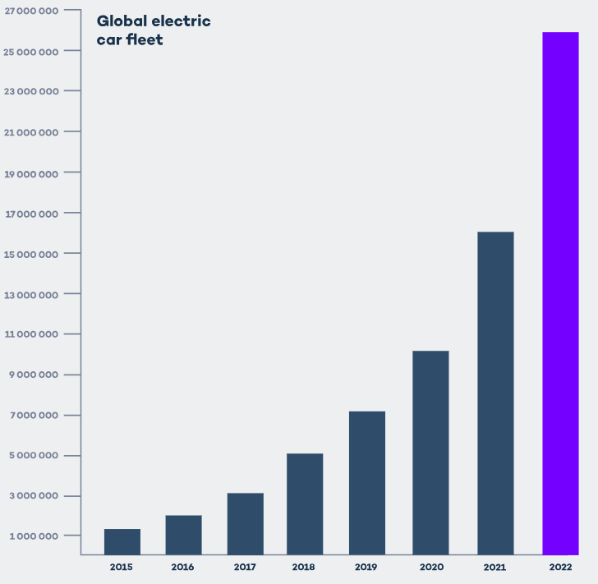
Current Day Scenario of E-Mobility
Introduction
EVs on the road were increased in 2022 by
55%
62%
While the Growth in Public charging infrastructure is by
Notes:
There is a massive growth in electric vehicles and related sector. Which can be seen by…..
The increment in numbers of EV on road can be seen in the graph

Slide 9
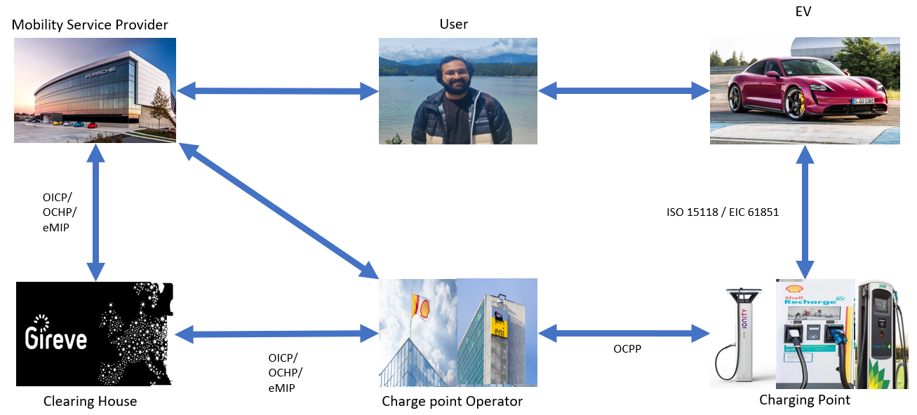
E – Mobility Charging Backend Communication Infrastructure
Introduction
Key Benefits
Facilitations of interoperable charging services.
Provision of Smart operations and real time status update to user.
Access to multiple charging station using single contract.
Notes:
The growth is evidence in the advancement in EV ecosystem and charging infrastructure. And it can be said that both are perpetually dependent. The innovation in EV charging infrastructure attract new customers and the growth in the domain makes stakeholders to innovate and improve their systems. Current day charging infrastructure provides variety of convenience feature to the customer and to fecilitate these features there are many backend and frontend actors play an important role.
Provision of smart operation such as, grid balancing, bi directional charging and features such a changing spot reservation and optimization.

Slide 10
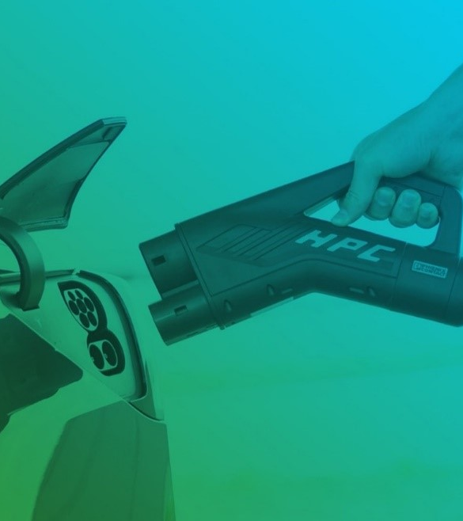
Problem Statement
Notes:
In this chapter we will see the objective of the thesis and the problem statement

Slide 11


Objective
Problem Statement
When EV is charged various KPI are monitored and communicated.
Notes:
These KPI are actully communicated from the connected feature of the vehicle and charging station to various actors such as CPO, clearing houses and MSP. This data is communicated by diffterent type of actors and systems using various protocols as discussed previously.

Slide 12





Objective
Problem Statement
When EV is charged various KPI are monitored and communicated.
Data consists of various charging sessions in different condition.
Automotive Manufacturers and Service providers can gain valuable insights from these data.
Notes:
This communicated data is then stored in the database of various entities according to their relevance. In this case the referred data has been collected from the MSP. Which includes various features or KPIs such as Geo location, BMS and Battery status, temperatures, charging power, current, state of charge and so on.

Slide 13
Problem Statement
DURING THE CHARGING PROCESS 3 ERRORS ARE LOGGED IN THE DATA
This type of error occurs when the charging of the vehicle is continued, however, there
has been an error occurred in any of the systems.
This type of error occurs when the charging of the vehicle is interrupted due to the error
occurring in any of the systems. The charging interruption indicates that charging power has been unexpectedly stopped for unintentional reasons during the process.
This type of error is logged in the database when the LED light on the EV has been
blinked or lit up indicating that there is an error in the charging process. During this error charging of the vehicle maybe continued or interrupted.
Error Detected but Charging Continued.
Error Detected and Charging Stopped
Error Shown on LED

Slide 14
Problem Statement
DURING THE CHARGING PROCESS 3 ERRORS ARE LOGGED IN THE DATA
THE LARGE AMOUNT OF DATA CAN REVEAL A LOT INSIGHTS SUCH AS,
Error Detected but Charging Continued.
With which CPO errors are happening more Frequently.
TO FIND FOR UNDERLYING PATTERNS IN THE CHARGING BEHAVIOUR OF THE VEHICLE.
WHICH KPI ARE CLOSELY RELATED OR CAN INDICATE THESE ERRORS?
Error Detected and Charging Stopped.
In which country vehicle is charged more with High Power chargers.
Error Shown on LED.
In which conditions vehicles are getting charged faster or slower.

Slide 15

Methodology

Slide 16
Methods of Analysis
Methodology
Avg_bms_current | Inititalize_method | Energy | Battery capacity | Start_SOC | End_SOC | Max_power | CPO | Charge Platform | Chargepoint_class | Country | Outside_Temperature | Login_duration | Kilometer | BMS_Temperature | Duration_until_currentflow | Error 1
-2 | RFID CARD | 1.02 | Big | 22 | 24 | 101 | EA | OCPI | 22 | USA | 10 | 30 | 3528 | 25 | 25 | True
147 | REMOTE | 11.25 | Big | 5 | 30 | 1125 | IONITY | HUBJECT | 350 | DE | 15 | 45 | 7862 | 42 | 19 | True
45 | REMOTE | 5.28 | Small | 80 | 96 | 528 | IONITY | HUBJECT | 11 | DE | 12 | 129 | 60456 | 37 | 30 | True
68 | P&C | 14.2 | Big | 32 | 63 | 1421 | ENBW | OCPI_DIRECT | 350 | DE | 11 | 30 | 45009 | 58 | 44 | False
43 | REMOTE | 11.67 | Small | 45 | 70 | 1167 | ELLI | GIREVE | 150 | AT | 4 | 41 | 22654 | 48 | 31 | False
-13 | RFID CARD | 2.32 | Small | 30 | 38 | 232 | SHELL | HUBJECT | 35 | NL | 2 | 50 | 6578 | 27 | 16 | True
322 | REMOTE | 13.27 | Big | 27 | 88 | 1327 | ISE | GIREVE | 150 | NL | 6 | 60 | 5125 | 47 | 15 | False
258 | RFID CARD | 18.67 | Big | 12 | 79 | 1867 | EAA | GIREVE | 11 | NL | 8 | 50 | 74580 | 18 | 22 | False
84 | RFID CARD | 8.53 | Small | 59 | 65 | 853 | IONITY | OCPI | 350 | DE | 15 | 10 | 15036 | 68 | 12 | True
13 | REMOTE | 0.86 | Big | 8 | 10 | 86 | EA | OCPI | 150 | USA | 23 | 4 | 30658 | 35 | 47 | True
214 | P&C | 12.14 | Big | 44 | 99 | 1214 | EA | OCPI | 150 | USA | 19 | 60 | 14525 | 51 | 54 | False
320 | RFID CARD | 24.33 | small | 15 | 90 | 2433 | ENBW | HUBJECT | 200 | DE | 5 | 135 | 5621 | 29 | 29 | False
Notes:
Here, I have created dummy data to explain which methodology I have used and why. It consists of one target class error and feature or KPI such as current flow during charging, SOC, CPO, temperature of BMS and enviromnent and so on

Slide 17
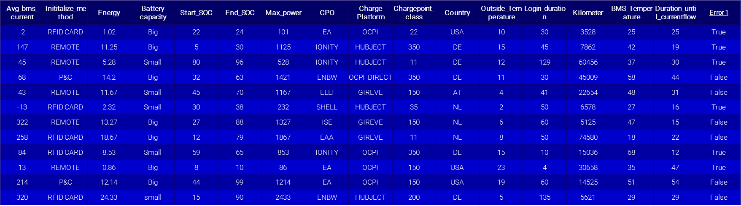
Methods of Analysis - Clustering
Methodology
Clustering
Notes:
To analyse a pattern in the overall dataset I am using clustering to get insignt about overall charging behaviour of the system.

Slide 18
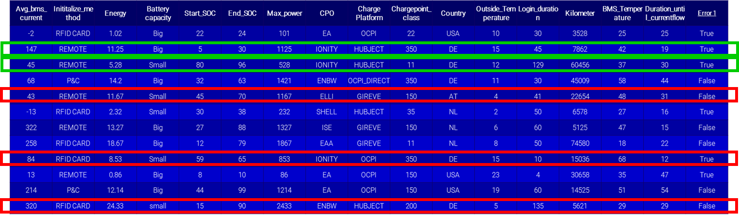
Methods of Analysis - Clustering
Methodology
This method is a type of Unsupervised machine learning. Task of dividing unlabeled data into such a manner that similar datapoints fall in the same cluster.
Clustering Technique used in this Thesis
K-Means
K-Modes
K-Prototype
Notes:
What exactly is clustering?
There are several types of clustering available, but for this data I have used K-means type of clustering techniques.
It is used because of the simplicity and efficiency of the algorithm. K means can be used on the large number of dataset and suitable for large scale analysis. K-means type of clusteirng can be used with high dimentional data as well.

Slide 19
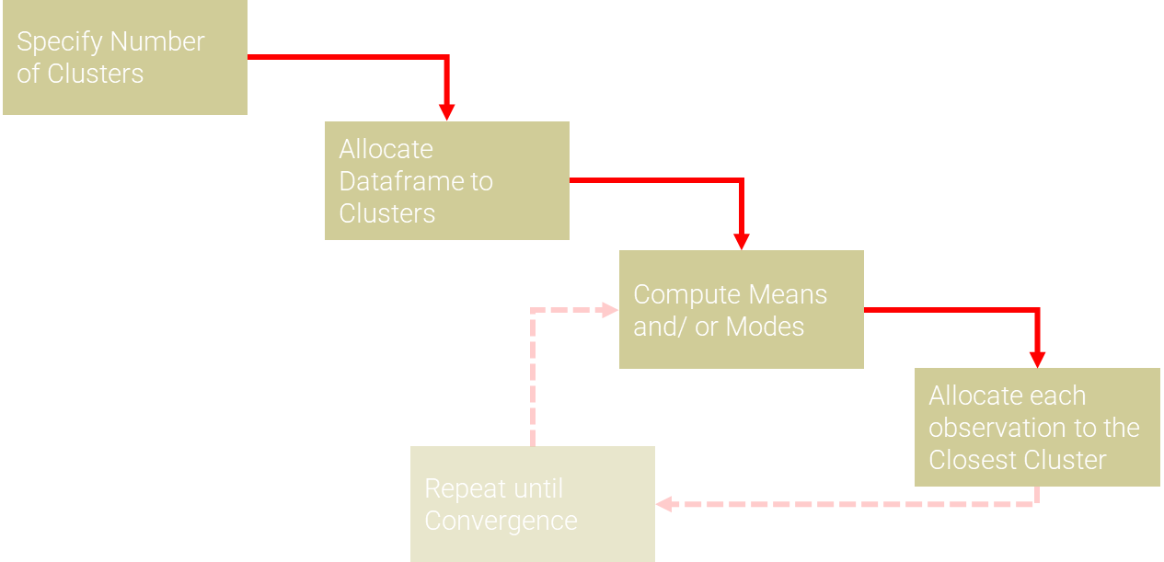
Methods of Analysis - Clustering
Methodology
Clustering Technique used in this Thesis
K-Means
K-Modes
K-Prototype

Slide 20
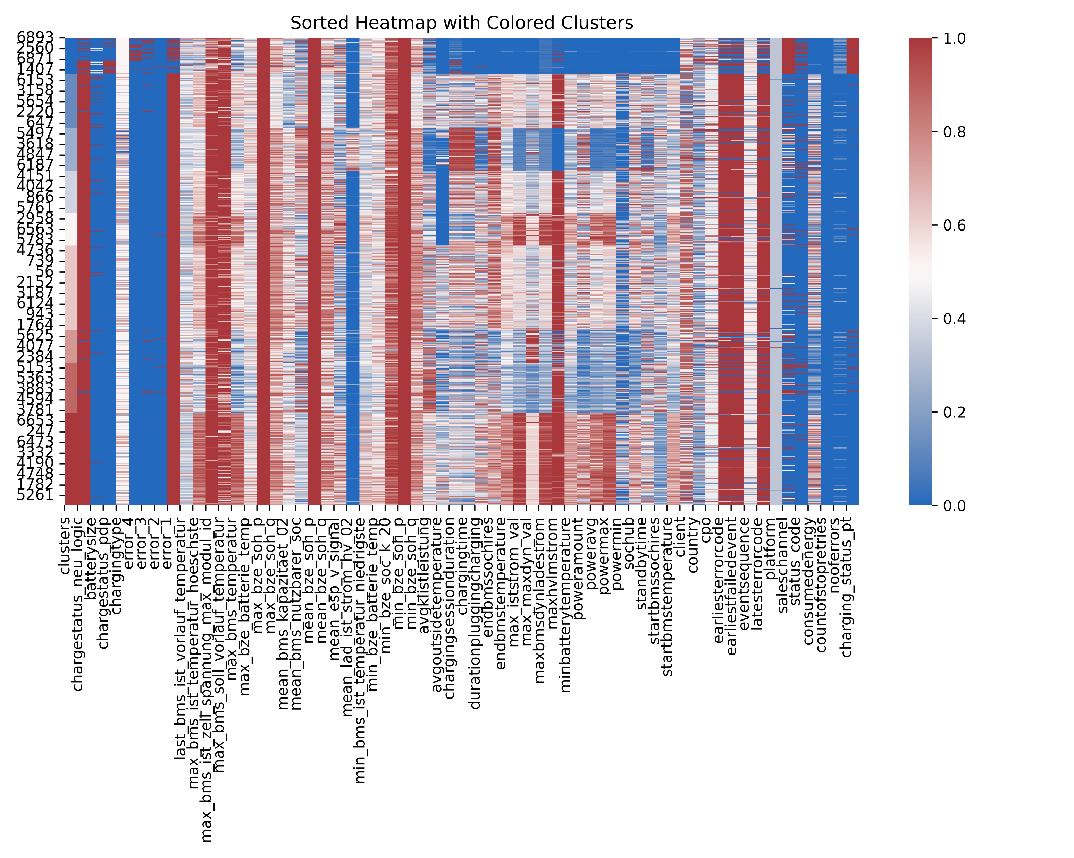
Methods of Analysis - Clustering
Methodology
Clustering Technique used in this Thesis
K-Means
Description of K-Modes Clustering
Description of K-Prototype Clustering
The algorithm uses the simple matching dissimilarity function to cluster data.
It eliminates limitation of feeding only numerical data to the alorithm.
This method is the most suitable method to cluster the categorical data. (Eg. Customer Preferences, Demographic Information, Charging Categories)
The algorithm uses Distance function and matching dissimilarity function both to cluster data.
This method is an improvement of the K-means algorithm and integrates functions of K-Modes to cluster categorical data.
Notes:
A result of clustering can be visulazed in the form of Heat maps or scatter plot to observe patterns in the data.

Slide 21
Methods of Analysis – Random Forest
Methodology
Random Forest
Avg_bms_current | Inititalize_method | Energy | Battery capacity | Start_SOC | End_SOC | Max_power | CPO | Charge Platform | Chargepoint_class | Country | Outside_Temperature | Login_duration | Kilometer | BMS_Temperature | Duration_until_currentflow | Error 1
-2 | RFID CARD | 1.02 | Big | 22 | 24 | 101 | EA | OCPI | 22 | USA | 10 | 30 | 3528 | 25 | 25 | True
147 | REMOTE | 11.25 | Big | 5 | 30 | 1125 | IONITY | HUBJECT | 350 | DE | 15 | 45 | 7862 | 42 | 19 | True
45 | REMOTE | 5.28 | Small | 80 | 96 | 528 | IONITY | HUBJECT | 11 | DE | 12 | 129 | 60456 | 37 | 30 | True
68 | P&C | 14.2 | Big | 32 | 63 | 1421 | ENBW | OCPI_DIRECT | 350 | DE | 11 | 30 | 45009 | 58 | 44 | False
43 | REMOTE | 11.67 | Small | 45 | 70 | 1167 | ELLI | GIREVE | 150 | AT | 4 | 41 | 22654 | 48 | 31 | False
-13 | RFID CARD | 2.32 | Small | 30 | 38 | 232 | SHELL | HUBJECT | 35 | NL | 2 | 50 | 6578 | 27 | 16 | True
322 | REMOTE | 13.27 | Big | 27 | 88 | 1327 | ISE | GIREVE | 150 | NL | 6 | 60 | 5125 | 47 | 15 | False
258 | RFID CARD | 18.67 | Big | 12 | 79 | 1867 | EAA | GIREVE | 11 | NL | 8 | 50 | 74580 | 18 | 22 | False
84 | RFID CARD | 8.53 | Small | 59 | 65 | 853 | IONITY | OCPI | 350 | DE | 15 | 10 | 15036 | 68 | 12 | True
13 | REMOTE | 0.86 | Big | 8 | 10 | 86 | EA | OCPI | 150 | USA | 23 | 4 | 30658 | 35 | 47 | True
214 | P&C | 12.14 | Big | 44 | 99 | 1214 | EA | OCPI | 150 | USA | 19 | 60 | 14525 | 51 | 54 | False
320 | RFID CARD | 24.33 | small | 15 | 90 | 2433 | ENBW | HUBJECT | 200 | DE | 5 | 135 | 5621 | 29 | 29 | False
Notes:
Now, in this dataset there are some features which are correlated with the error and certain values of combination of values can lead us to the prediction of whether there can be an error or not. To identify these important features we are using Random forest algorithm

Slide 22
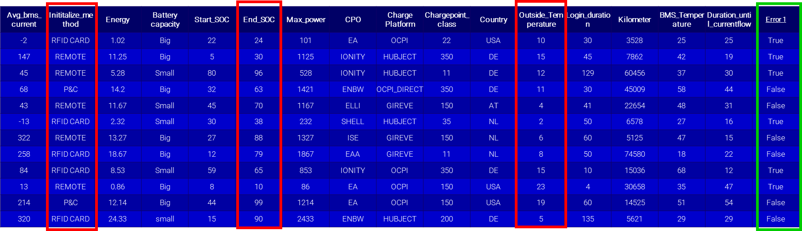
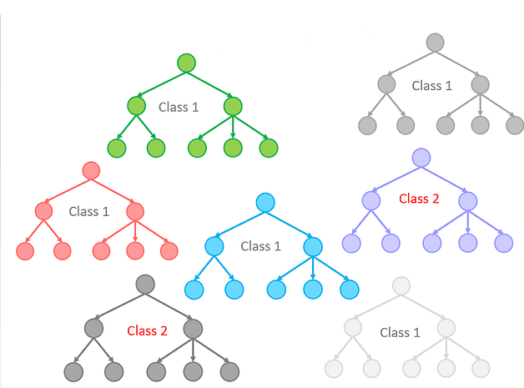
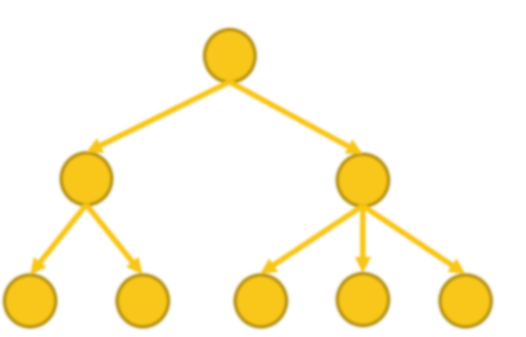
Methods of Analysis – Random Forest
Methodology
This method is a type of Supervised machine learning algorithm, made of several Decision trees which take features as an input and classify the targeted output.
Decision tree
Random Forest

Slide 23
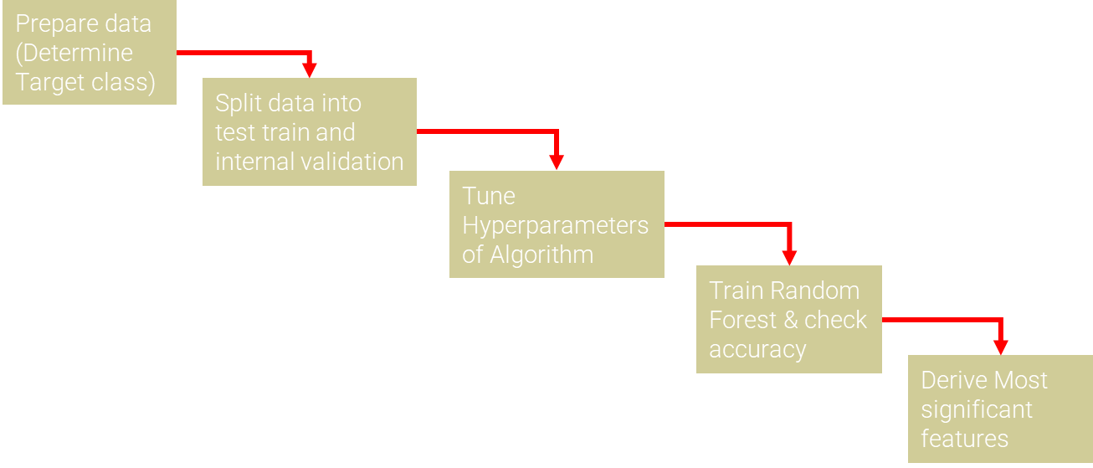
Methods of Analysis – Random Forest
Methodology
This method is a type of Supervised machine learning algorithm, made of several Decision trees which take features as an input and classify the targeted output.
Decision tree
Random Forest
Charasteristics of Random Forest
Each node of Random forest algorithm is traceable.
Traceability feature allows to find out significance of features with respected output class.
Easier to track the accuracy of an algorithm
Notes:
Now we wonder, how a classification task can reveal important features? Unlike neural networks trained random forest algorithm is traceble and can be said white box model depending on the use cases.

Slide 24
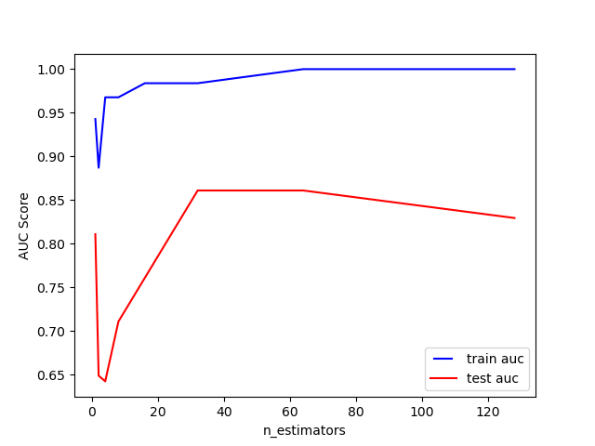
Methods of Analysis – Random Forest
Methodology
Train and Test Accuracy
Permutation Importance of
Features
Notes:
1st we take different numbers of random forest estimators and calculate accuracy and monitor where algorithm gives optimum number of results and not overfitting. Once these number of estimators are decided we train random forest on the set number of estimators. We then permute values of features for determined number of iterations and the feature which contributes much in the prediction of output class is identified as important feature.
However sometimes there are several correlated feature which all are important but the algorithm relies on only one of them and this feature dominates the Permutation importance output and which actually increases efforts to predict important features.

Slide 25
Methods of Analysis – Hierarchical Clustering of Collinear Features
Methodology
Spearman Correlation
Permutation Importance of
Features
Notes:
To identify these correlated features, Spearman correlation rank is used. Which is distributed between -1 and 1 . 0 means features are not correlated and negative and positive values determine the neagtive and positive correlation respectively. Then the correlation rank is converted into distance matrix to create a dendrogram and hierarchical clustering. Once Hierarchical clustering is done, One feature from each cluster has been selected and random forest is again trained on these features and when prediction accuracy is above a considerable threshold, these features are permutated to find the importance with the target label..

Slide 26
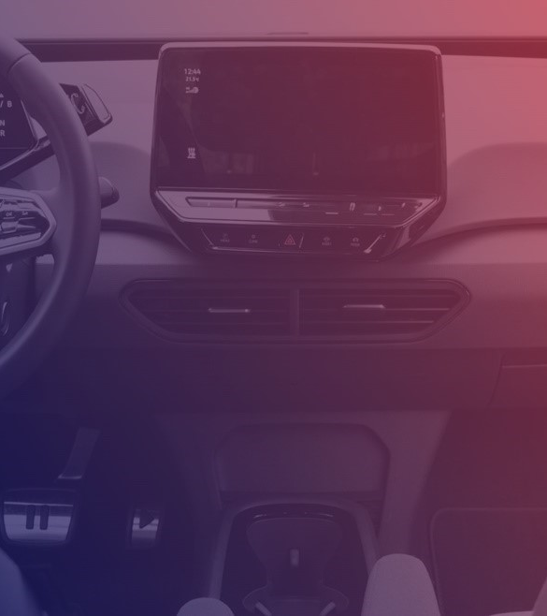
Results

